Slide 1
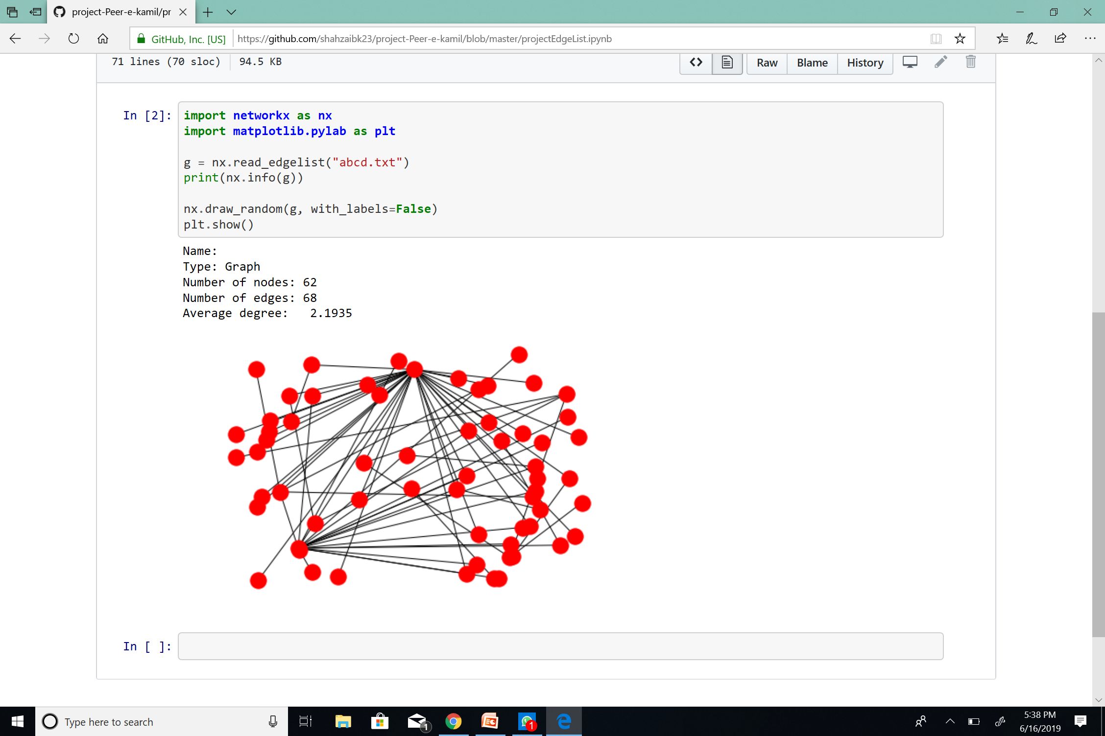
Peer – e – kamil 62 number of nodes 68 number of edges
2.1935 average degree
INTRODUCTION .
This project is based on graph of characters and their interaction with eachother. The characters in this project tends to work as vertices of the graph.

